Slide 2
Wireless Data transmission using patterns
Neha Kaushik (12BCE0076)
Viraj Sahai (12BCE0498)
Project ID - CSE499_I014

Slide 3
Introduction
We have developed a Wireless Transmission System that can be used for transmitting data between two systems within short ranges.
The display unit of any device, that wishes to transmit data, can be used as the transmitter.
A camera on the other end will act as the data receiver. It receives data by capturing images and decoding it to obtain the message.

Slide 4
MOtivation
Every year, almost as many as 1 lakh people across the globe lose their credit and debit card information because of using systems infected with worms that log key strokes and send them to the worm creators.
India ranks 3rd in the world in terms of having most infected PCs on the internet.
Our system transfers data without any user intervention using patterns that are encoded through a secure and private algorithm.
Such an approach would cut the use of keyboards and thus, effectively reducing any possible attack that happen in the interim.

Slide 5
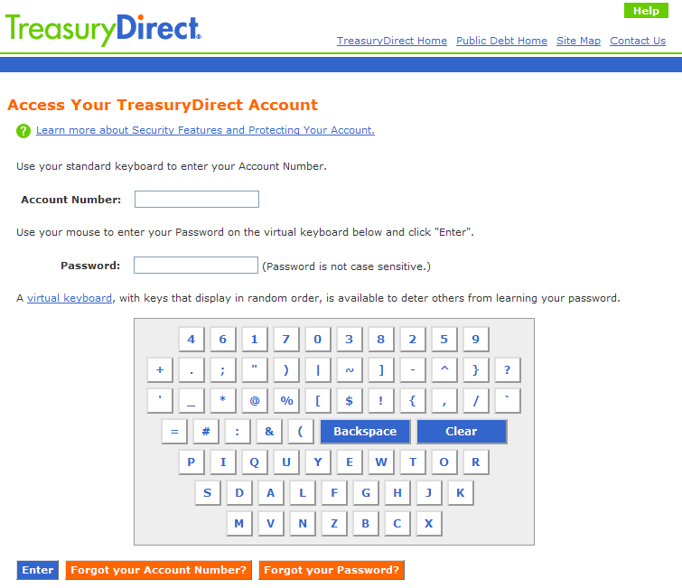
Present Solutions: VIRTUAL KEYBOARDS
Not many widely used and successful solutions are available as of now, however, most banks provide the option of using Virtual Keyboards.
Virtual keyboard is a software component allowing the user to enter characters. We usually find them in smart phones these days.
Banks employ virtual keyboards by taking input from the mouse and thereby trying to avoid keylogging thefts.

Slide 6
DRAWBACKS of virtual keyboards
Although it is more difficult than monitoring key strokes but hackers use malwares to record system screenshots at intervals and then forward them to themselves .
Virtual keyboards also increase the chances of theft through shoulder surfing as anyone around can easily peek into the screen and steal the sensitive information
Security and hidden cameras are used by crooks for recording the input by the user and thus stealing their personal information
Most implementations of virtual keyboards give visual feedback when a key is clicked. These visual feedbacks are nothing but state changes in the script of the page. Hackers can use malwares to read such information from the browser.

Slide 7
How we edge out virtual keyboards?
Shoulder surfing multiple patterns is more difficult than a few characters.
Even if cameras are used to record the sequence of patterns, the encrypting and decrypting algorithms will be kept private and safe with the bank servers.
Secure and private algorithms remove the possibility of reverse engineering to get the actual algorithms.
There are no visual feedbacks required as the scripts will just capture the pictures of the patterns and send them to the server.
Intermediate hacking during transmission will also be fruitless as data will travel as pictures and not in the form of any text.

Slide 8
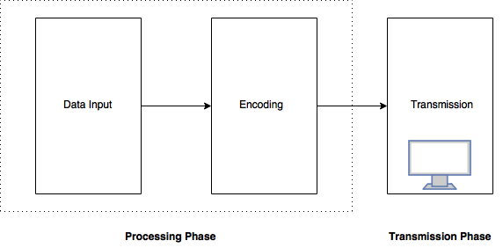
System Architecture
SENDER END
Processing Phase: The data is encrypted and encoded into patterns. As observed, considering our application, both data input and encoding stages are in the backend, hidden from user intervention.
Data Transmission Phase: The encoded data is transmitted in the form of flashing patterns on the display unit.

Slide 9
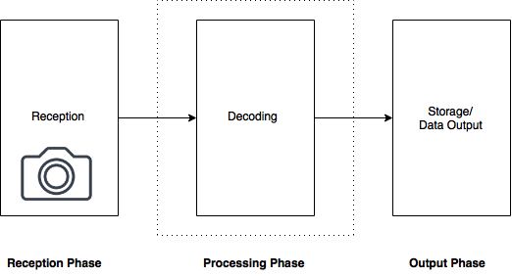
System Architecture
RECEIVER END
Reception Phase: Herein the data is received by the camera and then forwarded to the decoding stages.
Processing Phase: The received data is decrypted and decoded using decoding algorithms for obtaining the original data.
Output Phase: The decoded data is then displayed as an output either directly to the system or to the user as required.

Slide 10
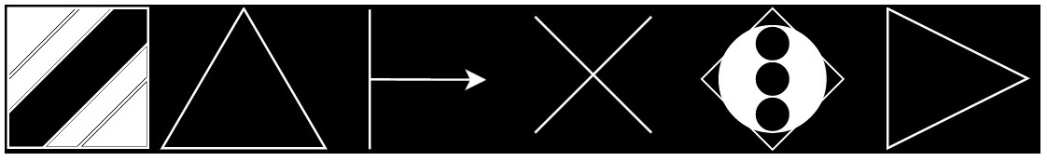
Methodology Adapted
For the purpose of encoding we have used basic symbols like:
The various patterns of these symbols are used to encode the ASCII characters.
For further simplification the first character of the code decides the type of character- special character, number, alphabet etc. This helps in limiting the search space and also for indexing for faster decoding.
At the receiver’s end, the images are captured, processed and decoded for obtaining the original data.
As discussed, both encoding and decoding algorithms are private to make it difficult to reverse engineer for the original data even if the patterns are physically captured by a hacker.

Slide 11
Hardware components
Camera Module : This is a 30 fps VGA camera that captures the transmitted data.
Bluetooth: The laptops come preinstalled with Bluetooth modules and these have been used for synchronizing the system
Computer System: Two separate laptops act as the sender and the receiver. The basic configuration of the system is approximately as:
Processor: Intel Core i3 clocked at 2 GHz
RAM: 4 GB
Storage space: Approx. 200 MB

Slide 12
Software components
Python 2.7: This is used to as the coding language for implementing the decoding and encoding algorithms.
OpenCV: For image processing.
NumPy: For matrix handling.
PyBluez: For handling Bluetooth operations

Slide 13
Proposed model for banks
The bank will push a secured certificate, containing the user’s bank details, to the user’s cellphone.
When ever a payment is need to be done, the user need to run the bank app on the phone and face the screen to the camera on the PC.
The bank, through its collaboration with GSM networks, pushes the encrypting key to the phone. The app uses it to encrypt data. Thus avoiding releasing the key on unsecured networks like internet.
The encrypted data is then encoded into patterns and displayed.
The camera records the patterns and transmits it to bank’s payment server.
The server receives the pictures and decodes and decrypts it to authenticate the transaction.

Slide 14
Advantages
Because of the secretive implementation almost impossible to hack as the algorithms shall remain private.
Furthermore, to be able to intercept data, hacker needs to be physically present for obtaining generated patterns. This further improves the reliability of the system.
Further improvement in camera capabilities and better pattern density shall enhance data rates.
No new devices need to be installed as these days almost every device involved in such transmissions comes equipped with a display unit and a camera.

Slide 15
Any Questions?

Slide 16
THANK you!

